Slide 1
Portal Import File

Slide 2
Portal Upload Options
Portal Files
Option 1 – Portal Manual Import Excel File
Option 2 – Portal COA Import Excel File

Slide 3
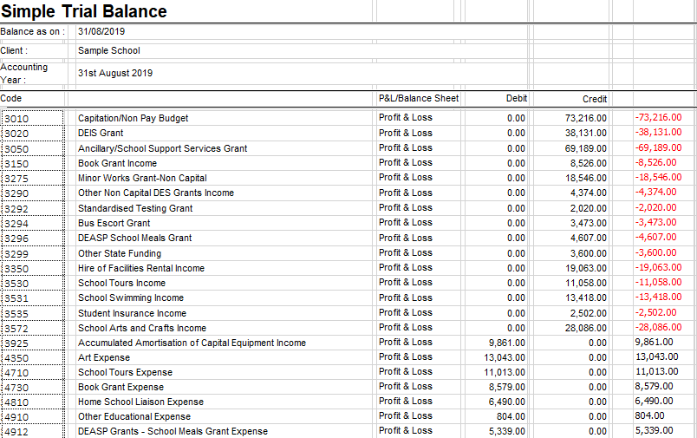
Option 1 - Portal Manual Import Excel File
Run your Trial Balance Report
Download ‘12345G_Portal_Manual_Import.xlsx’ from the FSSU website
Adjust your Trial Balance to positive and negative figures –
Negative figure imports as a Credit / Positive figure imports as a Debit

Slide 4
Option 1 - Portal Manual Import Excel
Copy and paste Trial Balance into the specified columns in the ‘Import’ worksheet
Input School Roll No.
Paste
Paste
Copy
Copy
Replace the sample Roll No. with the actual school’s Roll No. and save the file

Slide 5
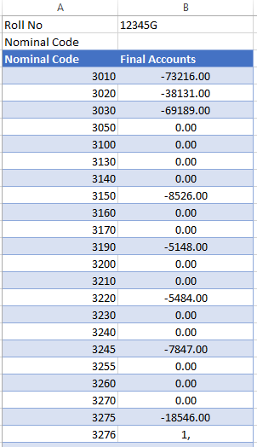
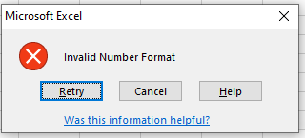
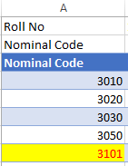
Option 2 - Manual COA Import Excel File
Download ‘12345G_Portal_COA_Import.xlsx’ from the FSSU website
Manually enter Trial Balance amounts into Column B beside the Nominal Code -
Negative figure imports as a Credit / Positive figure imports as a Debit
Input School Roll. No.
An error message will appear if the wrong number format is entered
Invalid Nominal Code will highlight and will not import
Replace the sample Roll No. with the actual school’s Roll No. and save the file

Slide 6
Both Import Options – Upload Rules
If the roll number in Cell B1 does not match the school the file will not import.
If nominal codes in cell A4 to A285 don’t match the following criteria they will highlight and won’t be imported:
1. Don’t match the nominal code in the Portal COA
2. Nominal code contains an Alpha
3. Invalid number formats
If any amount in cell B4 to B285 does not contain a positive or negative figure it won’t be imported
If the Worksheet is not named “Import” the import will not proceed
New imports will overwrite existing portal import with new nominal codes and values
Ensure the Trial Balance, balances to 0.00 before Import

