Slide 1


Using the
Accountant Report Template

Slide 2
Accountant Report
Import Trial Balance
  Option 1 - Manual Import Excel File
  Option 2 - Manual COA Import Excel File
Input Comparisons for Previous Year
Hide Rows with Zero Values
Create PDF Document
Create Portal File

Slide 3

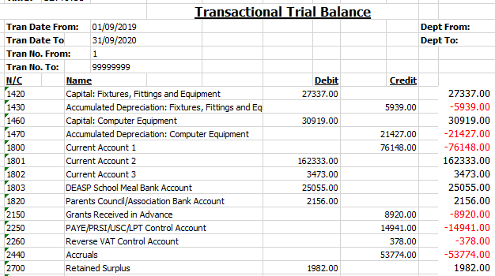
  Option 1 - Manual Import Excel File
Run your Trial Balance Report
Download ‘Accounts Manual_Import.xlsx’ from the FSSU website
Adjust your Trial Balance to positive and negative figures –
Negative figure imports as a Credit / Positive figure imports as a Debit

Slide 4



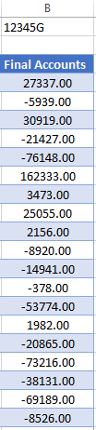

  Option 1 - Manual Import Excel File
Copy and paste Trial Balance into the specified columns in the ‘Import’ worksheet
Input School Roll No.
Paste
Paste
Copy
Copy

Slide 5
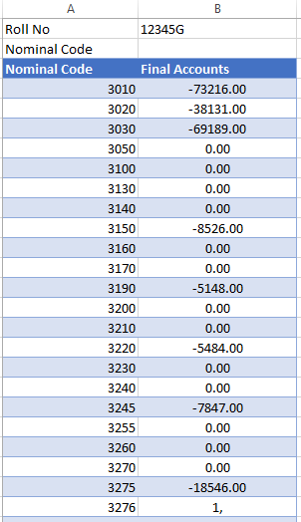
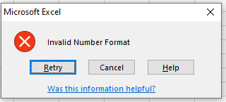
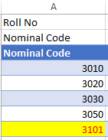
  Option 2 - Manual COA Import Excel File
Download ‘Accounts Manual_COA_Import.xlsx’ from the FSSU website
Manually enter Trial Balance amounts into Column B beside the Nominal Code -
Negative figure imports as a Credit / Positive figure imports as a Debit
Input School Roll. No.
An error message will appear if the wrong number format is entered
Invalid Nominal Code will highlight and will not import

Slide 6
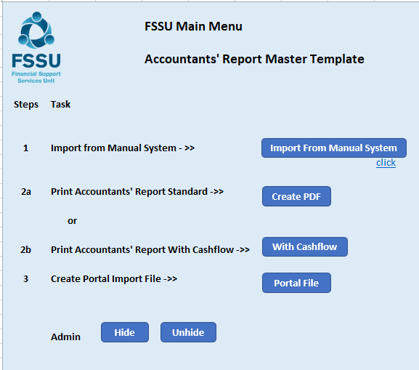
  Accountant Report Template
Download ‘Accountant Report Master Template ’ from the FSSU website
Select the Instructions Tab to view the FSSU Main Menu

Slide 7

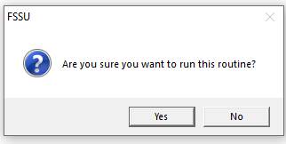
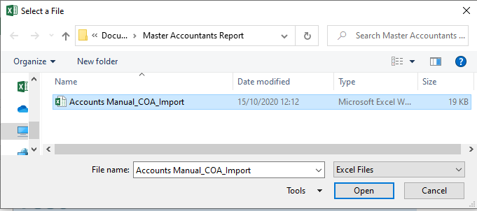
  Step 1 – Import from Manual System
Click on the Import From Manual System Button
Message appears asking if you want to run the routine – Yes to run / No to exit
Step 1 – Locate the populated saved file in your directory and open

Slide 8
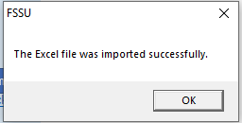
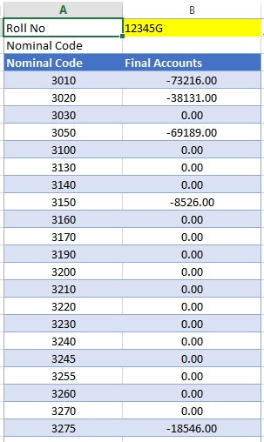
  Step 1 – Import from Manual System
Message appears showing the routine has ran successfully – Click OK
The Import has populated the ‘Import’ Tab in the Accountant Report

Slide 9
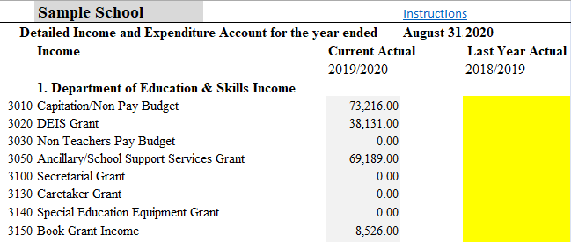
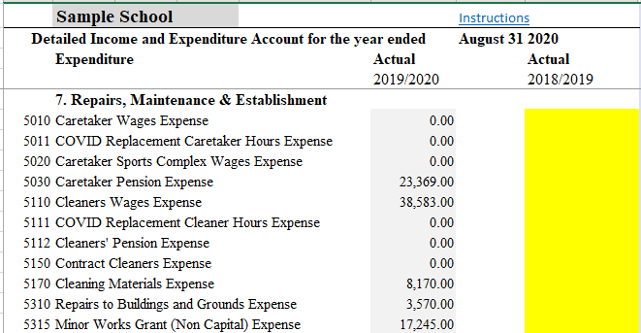
  Step 1 – Import from Manual System
Income and Expenditure Accounts populate automatically on import
Input Last Years Actuals as required

Slide 10
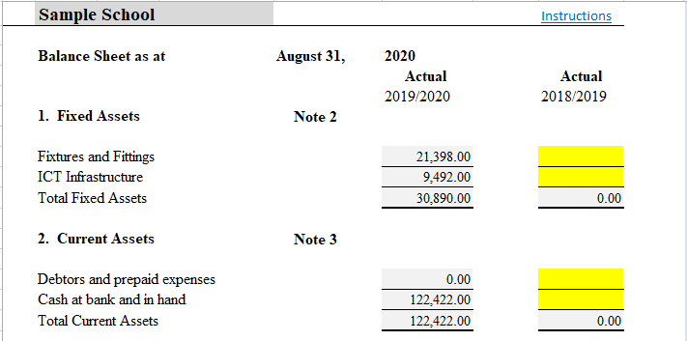
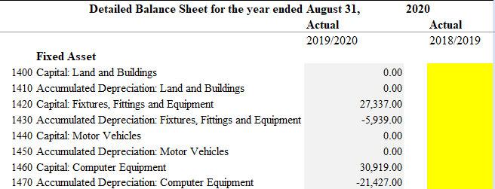
  Step 1 – Import from Manual System
Balance Sheet and Detailed Balance Sheet populate automatically on import

Slide 11
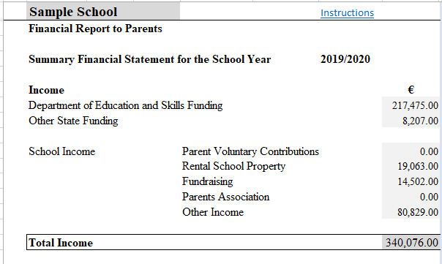
  Step 1 – Import from Manual System
Financial Report to Parents populate automatically on import

Slide 12
  Admin – FSSU Main Menu
Ability to Hide / Unhide rows with 0.00 values to customise and condense the template

Slide 13

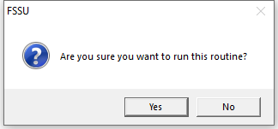
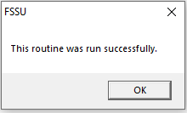
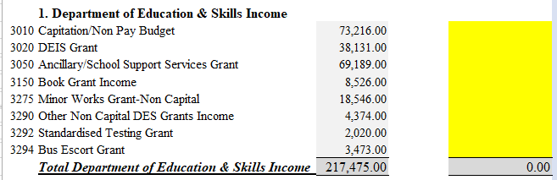
  Admin – FSSU Main Menu
Click on the Hide button to hide rows with 0.00 values
Message appears asking if you want to run the routine – Yes to run / No to exit
Routine has ran - Click Ok
Your file is now customised with 0.00 values hidden

Slide 14
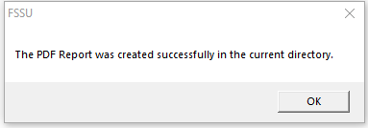
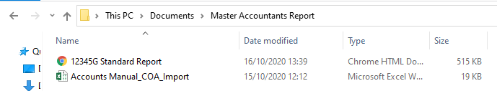
  Steps 2a and 2b – Create PDF
Click the button to create a standard PDF or PDF with Cashflow
Message appears asking if you want to run the routine – Yes to run / No to exit
Routine has ran - Click Ok
PDF appears on your screen and a copy will be saved in your current directory

Slide 15

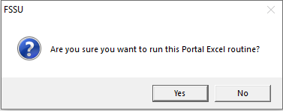
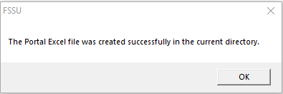
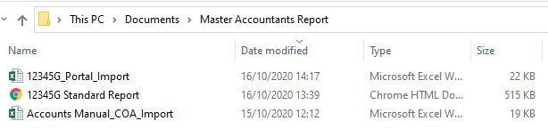
  Steps 3 – Create Portal File
Click the button to create Portal Import File
Message appears asking if you want to run the routine – Yes to run / No to exit
Routine has ran - Click Ok
The Portal Excel File has been saved in your current directory

