Slide 1



Financial Support Services Unit
Board of Management Reporting and Other Current Issues Webinar

Slide 2

Contact Us
Support Line
01 910 4020
Open 9am to 7pm
Website
www.fssu.ie
Email
primary@fssu.ie

Slide 3
Role of FSSU
Provision of advice and support to schools on financial governance matters
Development of templates for use by schools
Acting as a central repository for receipt of annual Board of Management accounts prepared by an external accountant.
Carrying out of audits as may be required.
Preparation of an annual report for the Department of Education & Skills (DES)
Liaison with the DES in relation to financial matters pertaining to Primary schools
Submission of financial information to the Charities Regulator which will also satisfy the financial reporting obligations placed on schools by the Charities Act 2009
Provision of statistical information to the Central Statistics Office (CSO) in relation to its requirements for financial information in respect of the school system
DES Circular 60/2017

Slide 4

Support from the FSSU

Slide 5
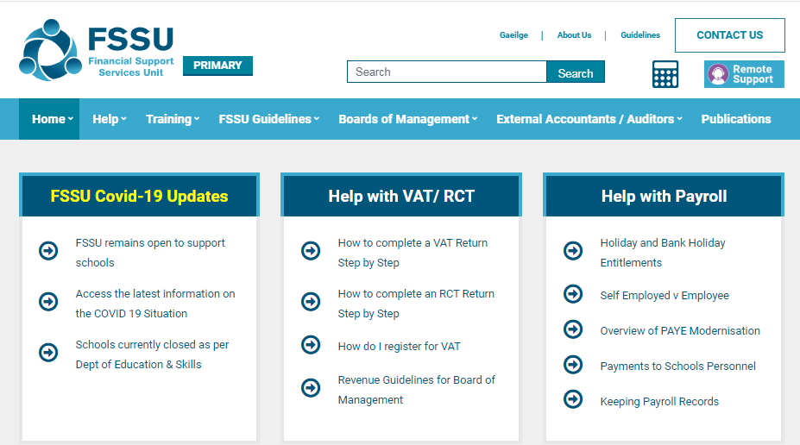
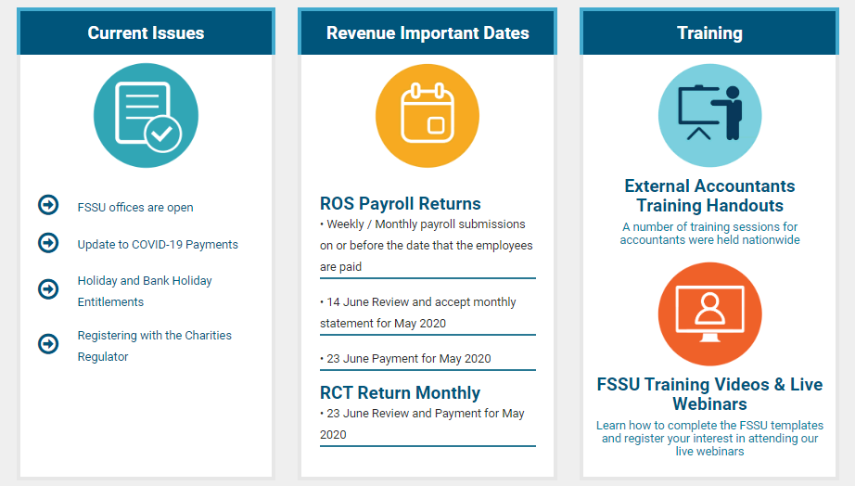

Slide 6
COVID-19
COVID-19 RELATED GRANTS
Minor Works (December Advance) | €5,500 per school + (€18.50 per student Main Stream School) (€73.00 per student Special School)
Minor Works Enhanced | €5,500 per school + (€18.50 per student Main Stream School) (€73.00 per student Special School)
Covid-19 Aide | €143.32 per Day <300 Students 2 Days 300-600 Students 5 Days >600 10 Days Special Schools 10 Days
Covid-19 Capitation Grant (Covid-19 Cleaning Grant) | 1/3 of €63 per Student paid Mainstream 1/3 of €73 per Student for students in a special class attached to a Mainstream school Special Schools increase on Ancillary by approx 36%
Covid-19 Capitation Grant (PPE & Sanitisation Grant) | €25 per student Mainstream €100 per student Special School To be Re-assessed in December 2020
Grant for Replacement of staff assessed as High Risk | Paid Two months in arrears

Slide 7


Internal Financial Controls
Payment Controls
Cheque / Banking Online Signatories
Supporting Documentation
Income Controls
Lodgements
Payment Collection
Revenue Compliance
Charities Regulator

Slide 8

Reports for Board of Management Meetings
FSSU Monthly Reporting Templates
Monthly School Income & Expenditure Report
Year to Date Report – Actual v Budget
Year to Date Report – Actual v Prior Year Actual
Other Information
Bank Reconciliation Statement
Payroll Report – Reporting on Gross to Net Wages
List of Outstanding Invoices to be Paid
Accruals and Prepayments
Capital Project Updates

Slide 9

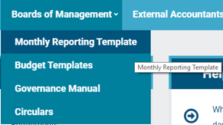
Monthly Reporting Template
Download the Monthly Reporting Template from www.fssu.ie
Save the file - Enable Editing and Enable Content

Slide 10
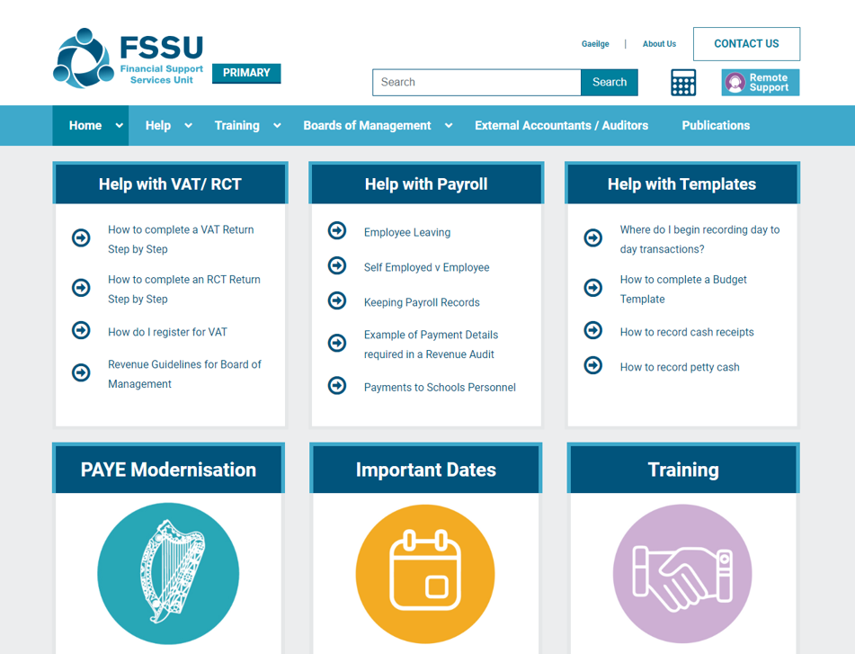
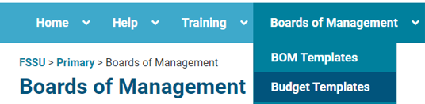
Completing the Budget Template
1. Download the Budget Template from www.fssu.ie
2. Save the file and Enable Editing

Slide 11

Revenue Compliance
Payroll
Payroll operated for Board paid staff only
  Payroll Software
  Outsource Payroll
Self Employed Versus Employee
Pay as Normal during Lockdown – Per Financial Guideline P15

Slide 12
Revenue Compliance
RCT / VAT
School obliged to register for RCT / VAT
Public Body - Not allowed to claim a VAT input credit
Revenue Guidance Note “Boards of Management – Relevant Contracts Tax/Value Added Tax”
File RCT / VAT via ROS and make payments to Revenue
School potentially subject to Revenue Audits

Slide 13
FSSU Online Submission
Accounts for the year ended 31st August 2020 (2019/2020)
Submission no later than the 28th of February 2021
Outstanding Accounts for the year ended 31st August 2019 (2018/2019)
The board is not in compliance with Section 18 of the Education Act 1998.
Those boards who have not made a submission may be subject to an audit by the FSSU.
The final deadline for late submissions of financial accounts for the school year 2018/2019 is no later than
5pm on Monday 31st August 2020

Slide 14

Questions
primary@fssu.ie
Support Line I 01 910 4020
www.fssu.ie

