Slide 1

Grants and Income received in Advance
Webinar
3rd June 2020
Notes:
Good morning
I would like to welcome you to our webinar on grants and income received in advance.
My name is Kathleen Moloney and I work as an accountant in the Financial Support Services Unit
We are running this webinar following requests for further training in this area.
There will be a presentation on Grants and Income received in advance and a demonstration on Surf Accounts on processing the transactions.
This will be followed by a questions and answer session. Please feel free to submit your questions during the webinar and these will be answered during the Q & A session.

Slide 2
Presenter
Kathleen Moloney
Accountant
Financial Support Services Unit

Slide 3
Agenda
    Introduction
    Grants overview
    Calculate advance grants
    School Generated Income in advance
    Create Departments in Surf Accounts
    Surf Accounts postings pre year end 31/08/
    Surf Accounts postings for the new year 01/09/
    Questions & Answers

Slide 4

Introduction
What is advance income?
This is income received in the current accounting period that belongs to future accounting years.

Slide 5

School Grants Overview
Non- Pay grant-Jan/Apr/Jul/Oct
Minor Works Grant-Jan/Apr/Jul/Oct
Non-Teaching Pay Grant-Jan/Apr/Jul/Oct
DEIS Grant -Sept
SSSF Grant- Mar/Jun/Nov
Book Grant-June
Supervision & Substitution Grant- Dec/Jun
Programme Grants-LCA, JCSP, TY, Physics and Chemistry.- June

Slide 6

School Accounting Year
The school accounting year runs from
September
to
August

Slide 7
Advance Grant Calculation.
Non-Pay Grant
The grant the school received in July is for the period July/August/September
The portion of the grant for September will be classed as an advance grant.
E.g.In July the school received non-pay grant of €33,031
Advance grant=(€33,031 divided by 3)=€11,010
Code 2150.

Slide 8
Advance Grant Calculation cont.
Non Teacher- Pay Grant
The grant the school received in July is for the period July/August/September
The portion of the grant for September will be classed as an advance grant.
In July the school received non-pay grant of €22,500.
Advance grant=(€22,500 divided by 3)=€7,500
Code 2150

Slide 9
Advance Grant Calculation cont.
School Support Services Fund
The grant the school received in June is for the period July/August/September/October
The portion of the grant for September and October will be classed as an advance grant.
In June the school received SSSF grant of €17,213.
Advance grant=(€17,213 divided by 4)
= €4,303 x 2 for two months=€8,606 Code to 2150

Slide 10

Advance Grant Calculation cont.
Book Grant
The book grant schools receive in June is for the next school year
e.g. the school received €10,000 in June
Advance Grant=€10,000 code 2150
If the school has paid for the books or paid the parents out the grant before the 31/08/2020 these payments are classified as Prepayments.

Slide 11

Programme Grants-Other
The school receives a number of grants that are not ring fenced and are for the current school year.
E.G. LCA, JCSP, TY, Physics and Chemistry, Traveller pupil, State examination grants .
These grants are paid in the current year to cover current year costs.

Slide 12
Surf Accounts
We will now look at processing these
transactions in
Surf

Slide 13
Unspent Grant Calculation
The supervision and substitution grant and the book grant are ring-fenced income and therefore cannot be used for any other purpose.
The unspent portion of these grants should be deferred until it is spent by the school on supervision and substitution or text books.
The unspent portion of the grant is posted to codes 2160/2170

Slide 14
Calculate Unspent Grants
Supervision & Substitution
3240 S&S Grant received €5,130
4150 S &S Grant expenditure €4,200
Unspent Grant = €930
Book Grant
3150 Book Grant Received €9,600
Book Grant Expenditure €8,900
Unspent Grant = €700

Slide 15

Capital Grants.
The school may receive grants for Capital projects from time to time.
This includes grants for buildings, fixtures, fittings and equipment, computer equipment etc.
Capital grant income is coded to 3900-3990
Capital Expenditure is coded to 1400-1480
Grants due are coded to 1730

Slide 16
Capital Grants
Example
The school receives an ICT grant of €30,000 and spent €20,000 in the current school year
DES ICT Grant Received €30,000
ICT Grant Expenditure €20,000
2165 ICT Grant unspent €10,000

Slide 17
Advance Income-Surf Accounts
All school generated income received in advance will be coded to account code 2105.
When entering the advanced income to Surf accounts it is vital to use the correct department.
This will enable you to run a report on code 2105 by department.
This report will give the figures for the income in advance for posting to the next school years accounts.

Slide 18

Advance -School Generated Income
Incoming First Year pupils
Transition Year pupils
School Administration Charges
Book rental Income
Voluntary Contributions

Slide 19
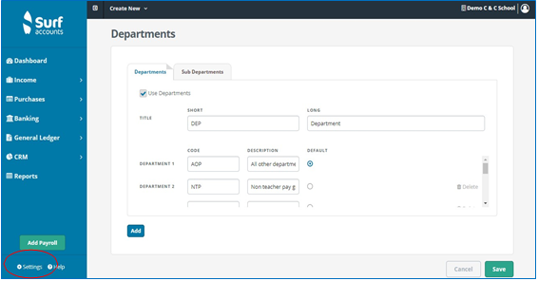
SURF Departments
Create departments for the various income streams if not already setup.
Transition Year
School Administration Charges
Book rental Income
Voluntary Contributions

Slide 20

New School Year
Transfer in the income that relates to this school year
1. enter the grants received in advance
2. enter school generated income received in advance

Slide 21
Summary-Income received in advance
Please identify grants received for the next school year
Process the transactions to the correct nominal code
Identify school generated income for the next school year
Process the transactions to the correct nominal code
Calculate the amount of unspent ringfenced grants
6. Process the transactions to the correct nominal code
7. In the new school year reverse the advanced income transactions

Slide 22
FSSU Website
Log on to
www.fssu.ie

Slide 23
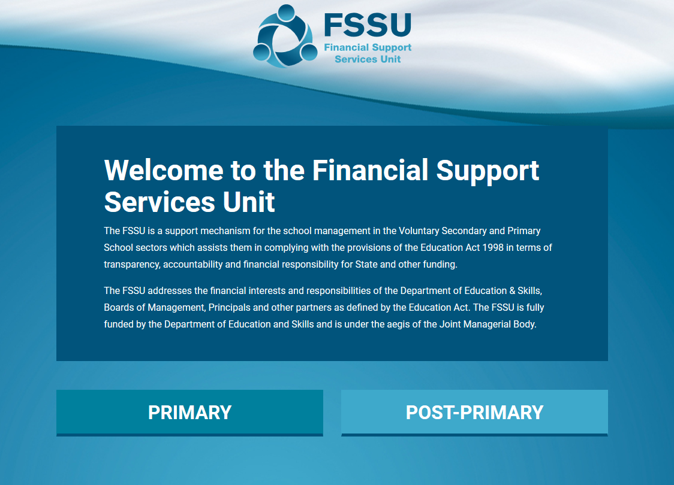

Slide 24
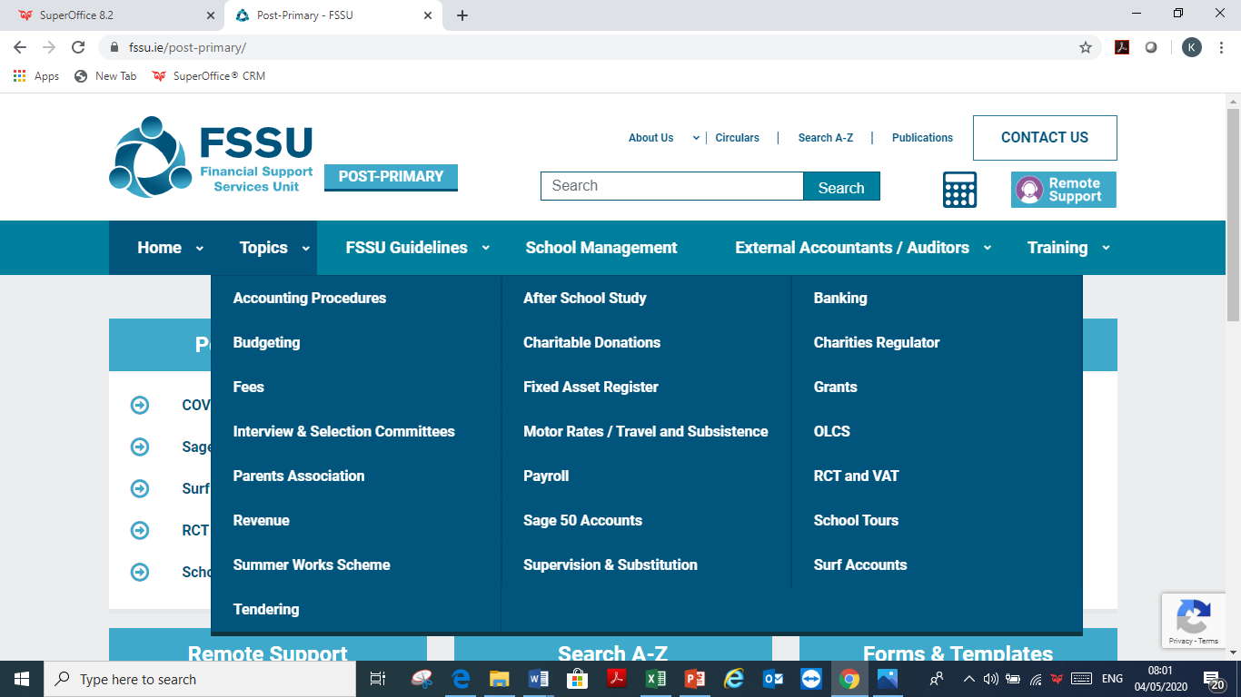

Slide 25
FSSU Assistance
If you would like assistance please contact us using the details below.
  Kathleen Moloney
  Mobile: 086 0405128
  Email: kathleenmoloney@fssu.ie
  Eileen Ahern
  Mobile: 086-8519116
  Email: eileenahern@fssu.ie
  eenahe
  Emma Kenny
  Mobile:086-7018874
  Email: emmakenny@fssu.ie

Slide 26
Thank You for joining the webinar

